Slide 1
Templates and Nav bar the right way
The best / default way to build our nav bar and our websites in future

Slide 2
"template" directory
Create a new directory "template"
Set up your default folders: css, assets, css.

Slide 3
Default files
create "styles.css" in css
Create "nav.php" in assets
Create "topbar.php" in assets
Create index.php

Slide 4
Index.php
Copy over the basic stuff you need:

Slide 5
New default file: common.php
Create "common.php" in assets
This is where a lot of our reusable code is going to go
Makes it reusable and a whole lot more maintainable.

Slide 6
Nav of old
I taught you using a table, and this is sort of ok...
But its not standard
Using an unordered list (ul) is considered standard
Apply some styling and you have an effective nav bar.

Slide 7
Edit your nav bar
We have been doing it the rudimentary way...
No we will learn it the proper way, as part of our template.
Open your nav.php to edit.
We are going to make a UL as this is the right way to do it.

Slide 8
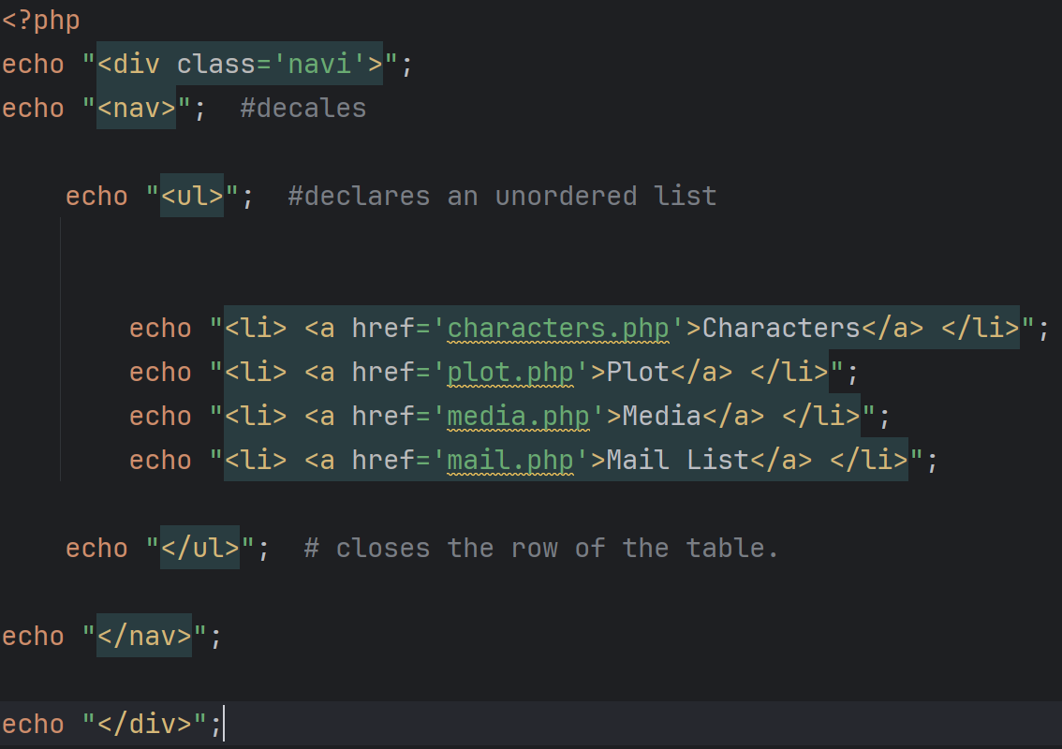
Nav.php or whatever you call it

Slide 9
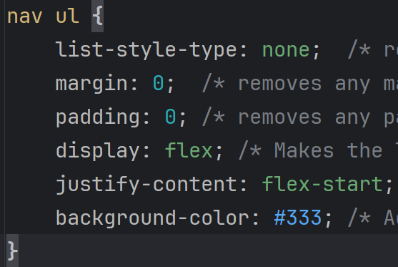
Styles.css or what ever you call it

Slide 10
From now on...
I will only accept this style of nav bar going forward.

Slide 11
Task:
Mini project 1
Mini project 2
Go and rework your nav bar to use the new system.

